Slide 1
Science Fair 2023-2024
YOUR School Registration due no later than September 15th. Email to bmadewell@lecs.org or yingexpofair@gmail.com
Pre-approval paperwork DUE no later than October 20th Remember: TEACHERS submit student forms and research plan in ONE pdf (per student) into Google classroom
Fixes (only if submitted first time before 10.20)
Due November 10th
This Photo by Unknown Author is licensed under CC BY-SA-NC

Slide 2
Forms for Everyone!
1—Adult Sponsor
1A—Student Checklist with RESEARCH PLAN INCLUDED!
1B—Approval Form
Form 3-Risk Assessment
Abstract on Official Form (after pre-approval)
This Photo by Unknown Author is licensed under CC BY-SA-NC

Slide 3
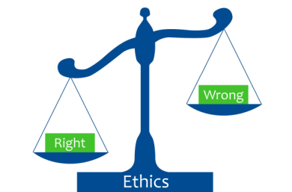
ISEF Ethic Statement and Presentation Guidelines
Ethics statement: Addresses integrity, legality, respect for confidentiality and intellectual property, and stewardship of the environment. Student researchers, as well as adults who have a role in their projects, are expected to maintain the highest ethical standards.
Presenting literature reviews and “data only projects” on boards at Ying correctly
Data only or literature review research plans—
Display OWN WORK ONLY, NOT OTHERS
This Photo by Unknown Author is licensed under CC BY-SA-NC

Slide 4
It is all about SAFETY
Document and share ”how to” for all tools, equipment, procedures, testing, etc.
If in doubt add instructions.
All projects are about the safety of the experimenter, subjects and mentors/sponsors.
Duplicate! Research Plan, Form #3 Risk Assessment, Bibliography and possibly other forms.

Slide 5
Pre-approval Form Tips
If you need pre-approval THE TEACHER WILL digitally submit the following forms as ONE PDF per student via Google by October 20, 2023:
1, 1A, the research plan, 1B and 3 (everyone needs Risk Assessment form and a research plan
You also will need one of these options if:
Humans: 2, 4 and Informed Consent Sample
Vertebrates-2, 5A,5B
PHBAs -2, 6A, RRI facility approval and QS
Vertebrate Tissues 6A and 6B
Continuation projects need pre-approval Form 7
Hazardous chemicals or devices Form 3 only
This Photo by Unknown Author is licensed under CC BY-SA
This Photo by Unknown Author is licensed under CC BY-NC-ND

Slide 6
Summer Projects
Projects done at summer programs should still be sent for pre-approval, but must have approval letter from the research institution (Dean, Dept Head or President)

Slide 7
Specialized Facility
All students working at Regulated Research Institution (RRI), shooting range, archery range, a business, etc.
ALL students working at an RRI needs a letter from the department head or other administrator (not lab-head)

Slide 8
Preapproval for Hot Button Topics
ETHICS (plagiarism, falsification, overstating)
Human Subjects
NO medical diagnosis from the student
Vertebrate Animals
Potential Hazardous Biological Agents (PHBAs)
Bacteria
Human/Vertebrate Tissues
Firearms, Drones, etc. (check for FAA guidelines and approval)
Medical device APPS: will most likely need FDA approval
All research done at a Regulated Research Institution (the proper documentation)
Continuation Projects
No Research Plan means No Pre-Approval! What can we approve?

Slide 9
CORE ISSUES
Students need to respond in a timely manner MEET Deadlines please
Project plan does not accurately describe experiment
Abstract details incorrect- improve summary of project
Lack of documentation details for pre-approval
Student overstating what student actually completed
Documenting on board mentor or other person’s work
Student Intervention: Surveys, opinions or potential use of prototypes
RRI lab: All names need to be listed, who completed what work and how it was related to or different from

Slide 10
Ethics and Integrity of Research
AI/CHAT GPT “norms” be very careful
Provide proper crediting to others
iThenicate.com software.
Remember students have legal consequences if plagiarizing
Check Science Buddies

Slide 11
Changes to 2023-24 ISEF rules
Human Participants: #6 a,b,c
HP Involvement-→ student intervention with surveys, opinions, prototypes
PHBA’s:
#10 PRIONS in RRI only
#11. Animal waste/sludge now BSL-2 lab only
#7 MDRO’s (multiple drug resistant organisms) limited and require written justification for use
#8 MDRO’s restrictions see 8 a and b
#6 reminder NO BSL3 or BSL4 facilities
1C Regulated Research Institution/Industrial Setting form should address adult supervision and CONDITIONS of research meaning.......
1C----RRI lab: All names need to be listed, who completed what work and how it was related to or different from the project

Slide 12
Human Subjects Projects
Requires form 2, 3 and 4 and Sample Human Consent form
DO NOT SEND IN SIGNED CONSENTS ESPECIALLY AT PRE-APPROVAL, you are not approved to start until after pre-approval
Survey/music/games MUST BE INCLUDED FOR PRE- APPROVAL
Do not send Consents after pre-approval, send VIC at FINAL REGISTRATION
Need Human Subjects citation in bibliography (see inside ISEF Rulebook for options)
TEACHER keeps verification 3 years Surveys from student MUST go through parent email
Parent MUST provide written consent for on-line surveys completed by minor.
Due to new Florida law: Teachers please have access to and keep a copy for yourself verifying parental approval

Slide 13
Human Subjects REVIEW PAGES #8-11
No ingestion
If done at a research institution the institutional IRB is required
Protected classes may not be sampled by student
ISEF RULE UPDATE:
No diagnosis of disease by student researcher
Engineering projects require IRB review if being tested on more than single student researcher/adult sponsor (may need to be approved by FDA or Medical Practices Act)

Slide 14
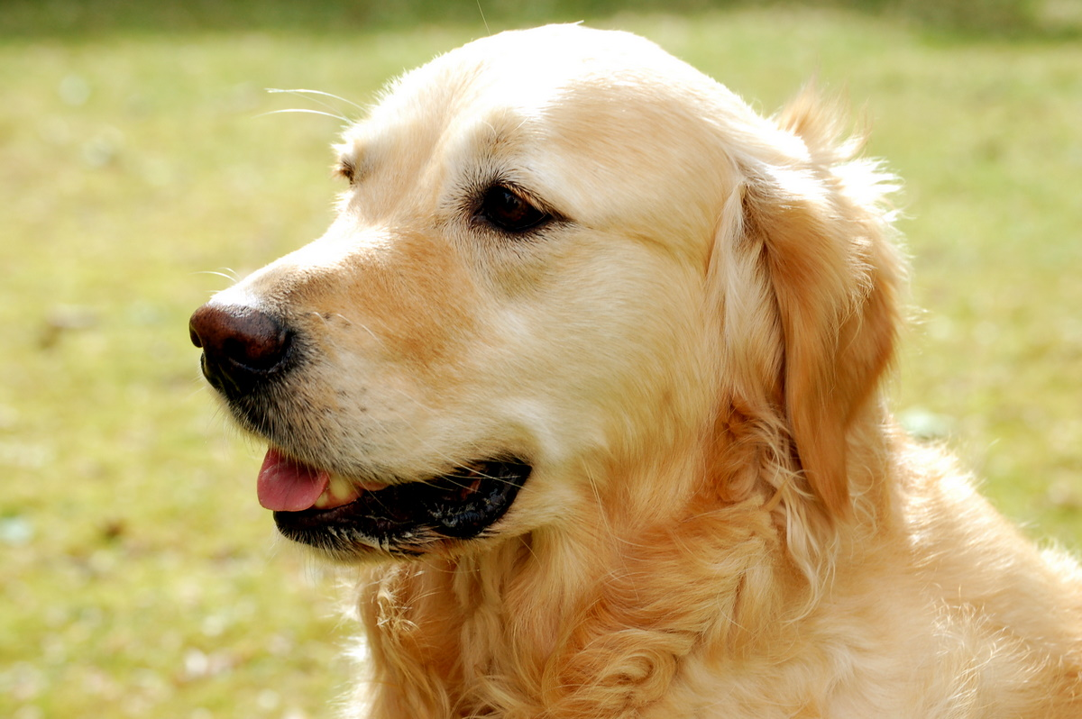
Vertebrate Animals
Have I said this is a terrible idea?
Cannot induce distress, harm or death
Studies at regulated research institution require an IACUC
Death requires necropsy
Need either 5A or 5B
Observational is OK as long as no modifications in environment
Need animal care citation (look inside ISEF rulebook for options)
FSSEF requires a mortality report
This Photo by Unknown Author is licensed under CC BY-SA

Slide 15
Potentially Hazardous Biological Agents (PHBAs)
Includes organisms like bacteria, mold, slime mold, no active algae blooms, vertebrate tissues—
No red tide research
Classified as BSL1 and BSL2 (ALL BSL2 must be done at a Regulated Research Institution (RRI) and Junior Division may only do BSL1
Requires form 6A and/or 6B with possible BSL1 checklist
No projects with emerging pathogens carried by arthropod vectors
No COVID-19 using virus
Need PBHA citation--look inside ISEF rulebook for options and include disposal (autoclave or 10% bleach)
This Photo by Unknown Author is licensed under CC BY-SA

Slide 16
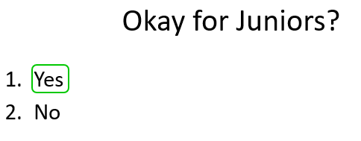
PHBAS
If plate remains taped closed and QS assists!

Slide 17
PHBAS
If plate remains taped closed with QS or DS!

Slide 18
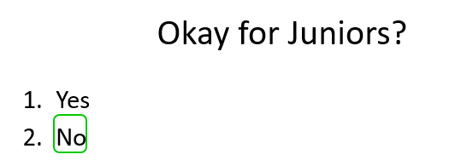
PHBAS

Slide 19
PHBAS

Slide 20
Senior projects: NO OPEN culture growths in BSL-1 lab.
Once plate is OPENED it becomes a BSL-2 and can not be done in a high school lab unless the lab is BSL-2 certified.

Slide 21
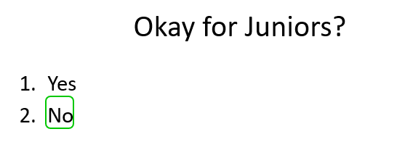
PHBAS

Slide 22
PHBAS

Slide 23
PHBAS

Slide 24
PHBAS

Slide 25
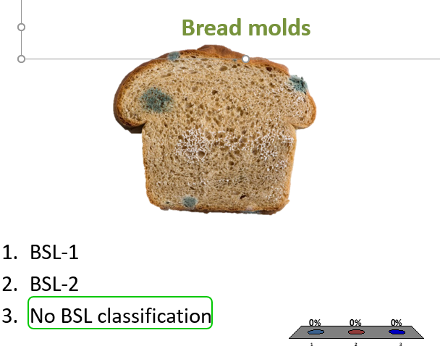
PHBAS

Slide 26
PHBAS

Slide 27
PHBAS
If plate remains taped closed!

Slide 28
PHBAS

Slide 29
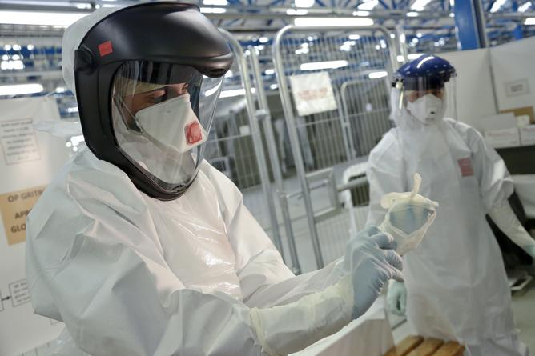
PHBAS DISPOSAL
Autoclave or 10% bleach
This Photo by Unknown Author is licensed under CC BY-ND

Slide 30
IMPORTANT ISEF AND STATE RULES for PHBAs
PHBAs-Insertion of antibiotic resistance markers for the clonal selection of bioengineered organisms is permitted, with the following exceptions:
Students are prohibited from the insertion of antibiotic resistance traits…
Students are prohibited from designing or selecting for multiple drug resistance organisms…
No studies using COVID 19
All viral studies for seniors must be in RRI
PRIONS only in RRI

Slide 31
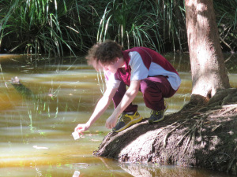
SSEF Rule on Environmental Water Sample Collection (aka red tide)
Students must show documentation that water samples were NOT collected during a red tide or cyanobacteria bloom when collecting water samples.
Please consider using https://protectingfloridatogether.gov/water-quality-status-dashboard
https://myfwc.com/research/redtide/statewide/
https://oceanservice.noaa.gov/facts/redtide.html
https://floridadep.gov/AlgalBloomWeeklyUpdate
BY

Slide 32
Sample Collection of Plants and Invertebrates
Need state or federal permits to collect invertebrates or plants.
A lot of attention on invasive species.
Be careful where you buy organisms too! Just because you purchase it in Florida does not mean it is legal to use or release in the state.
https://www.invasivespeciesinfo.gov/subject/lists
https://www.invasiveplantatlas.org/
DPI Permits --Permits@FDACS.gov
Helpline--352-395-4600
FDACS-08208 Permit

Slide 33
Risky Chemicals
No!!! Prescription Drugs requires pre-approval and guidance of qualified scientist (none allowed to be given to humans)
No CBD Oil
Proper Disposal
This Photo by Unknown Author is licensed under CC BY-NC-ND

Slide 34
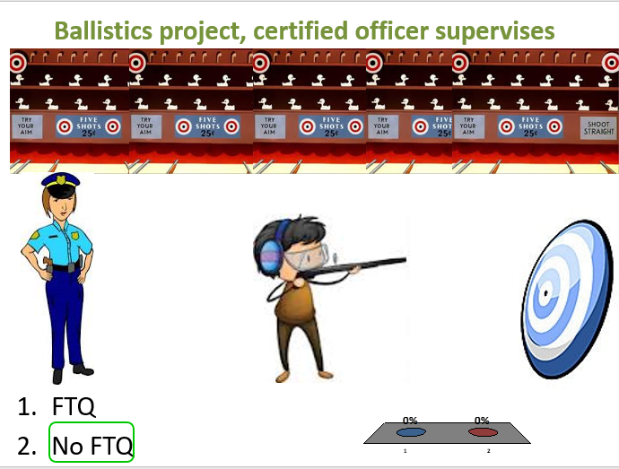
Projectiles

Slide 35
Projectiles

Slide 36
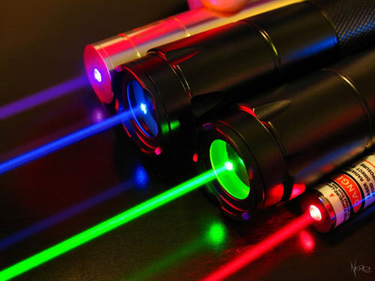
Lasers
Require pre-approval

Slide 37
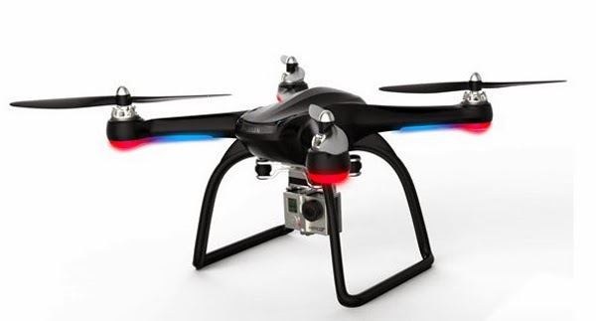
Drones
Projects involving unmanned aircraft systems (UAS)/drones must follow all state, Federal, and country laws. See the Federal Aviation Administration(FAA) for more details (www.faa.gov.uas/registration).
Get pre-approval
This Photo by Unknown Author is licensed under CC BY-SA-NC

Slide 38
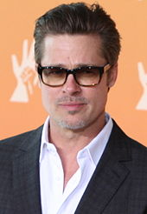
A few final pointers on Display and Safety. No Self-Promotion or External Endorsements.
No photos of others without authorization
No photos of anyone under 21, except the researcher
No Logos or BRANDS (one small logo of student designed product, but that is it)
This Photo by Unknown Author is licensed under CC BY
This Photo by Unknown Author is licensed under CC BY-SA-NC
This Photo by Unknown Author is licensed under CC BY-SA

